Slide 1


Study of Biochemical tests in diabetic Patients
Program Name - M.Sc. (Biochemistry) Sem 4
Notes:
NOTE:
To change the image on this slide, select the picture and delete it. Then click the Pictures icon in the placeholder to insert your own image.

Slide 2
CONTENTS
INTRODUCTION
AIM AND OBJECTIVE
MATERIALS AND METHODS
WORKING PRINCIPLE OF ELISA
OBSERVATION TABLES
CONCLUSION

Slide 3
INTRODUCTION
The word “diabetes” is Greek for “siphon,” which refers to the copious urine of uncontrolled diabetes. “Mellitus” is Latin for “honey” or “sweet,” a name added when physicians discovered that the urine from people with diabetes is sweet with glucose
Diabetes mellitus is a chronic metabolic disorder characterized by hyperglycemia (high blood sugar). This is caused by either a decreased production of insulin by the pancreas or by the body's inability to use insulin effectively. Insulin is a hormone that helps the body to use glucose for energy.
The biochemical changes that occur in diabetic patients can affect many different systems in the body. Some of the most common changes include:
Increased blood glucose levels. This is the hallmark of diabetes and can lead to a number of complications, including heart disease, stroke, blindness, and kidney failure.
Increased levels of fats in the blood. This can lead to high cholesterol and triglyceride levels, which are also risk factors for heart disease.
Changes in protein metabolism. This can lead to muscle wasting and weakness.
Changes in electrolyte balance. This can lead to dehydration and other problems.
Inflammation. This is a chronic low-grade inflammation that is thought to contribute to the development of complications in diabetes.
The biochemical changes that occur in diabetic patients can be complex and vary from person to person. However, by understanding these changes, doctors can better diagnose and treat diabetes and prevent complications.

Slide 4
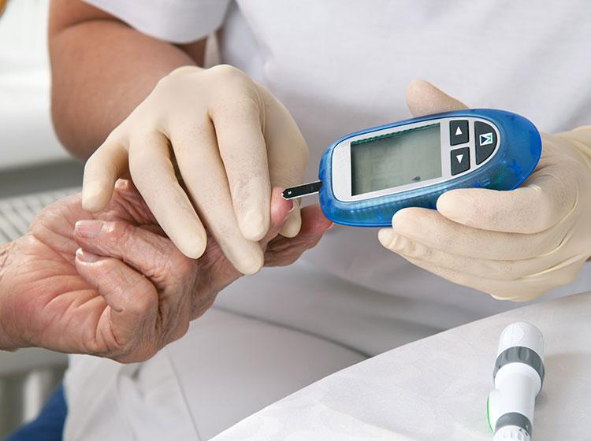

Here are some additional details about the biochemical changes that occur in diabetic patients:
Increased blood glucose levels. As mentioned above, this is the hallmark of diabetes. High blood sugar levels can damage cells throughout the body, leading to a number of complications.
Increased levels of fats in the blood. This is a common problem in diabetic patients and can lead to high cholesterol and triglyceride levels. High cholesterol and triglycerides are risk factors for heart disease, stroke, and other cardiovascular problems.
Changes in protein metabolism. Diabetes can affect protein metabolism in a number of ways. For example, it can lead to muscle wasting and weakness. It can also lead to changes in the levels of certain proteins in the blood, such as albumin.
Changes in electrolyte balance. Diabetes can affect the balance of electrolytes in the blood, such as sodium, potassium, and chloride. This can lead to dehydration and other problems.
Inflammation. There is increasing evidence that chronic low-grade inflammation is a feature of diabetes. This inflammation is thought to contribute to the development of complications, such as heart disease, stroke, and kidney disease.
The biochemical changes that occur in diabetic patients can be complex and vary from person to person. However, by understanding these changes, doctors can better diagnose and treat diabetes and prevent complications.

Slide 5
AIM AND OBJECTIVES
The aim and objectives of the study of biochemical tests of diabetic patients include:
To determine the normal ranges for biochemical parameters in diabetic patients. This information can be used to identify patients who are at risk for developing complications.
To identify biochemical markers that can be used to predict the development of diabetic complications. This information can be used to target preventive interventions for high-risk patients.
To develop new treatments for diabetes that can improve the metabolic control of patients and reduce the risk of complications.
Diabetes is the leading cause of kidney failure, accounting for 44% of new cases in 2005.

Slide 6
MATERIALS AND METHODS
The study of biochemical tests of diabetic patients is an important part of the management of this chronic disease. By understanding the biochemical changes that occur in diabetes, doctors can better assess the risk of complications and develop effective treatment strategies. Here are some specific biochemical tests that are commonly performed in diabetic patients:
Blood glucose: This is the most important test for monitoring diabetes. Blood glucose levels should be checked regularly to ensure that they are within the target range.
Hemoglobin A1c: This test measures the average blood sugar level over the past 3 months.
C-peptide: This test is measured to determine the difference between insulin the body produces and insulin that is injected into the body.
Insulin test: This test help doctors find the cause of hypoglycemia and other conditions related to abnormal insulin production.
These are just a few of the many biochemical tests that can be performed in diabetic patients. The specific tests that are ordered will vary depending on the individual patient's needs profile picture.
Type 1 diabetes is characterized by a lack of insulin production and type 2 diabetes results from the body’s ineffective use of insulin

Slide 7
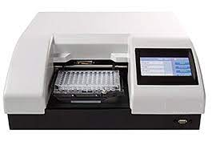
Working Principle of ELISA
Type 2 diabetes is much more common than type 1 diabetes, and accounts for around 90% of all diabetes worldwide.
ELISA tests can be used to detect the presence of antibodies to certain proteins that are involved in the development of type 1 diabetes. These antibodies include:
GAD antibodies: GAD stands for glutamic acid decarboxylase. GAD is an enzyme that is involved in the production of insulin. Antibodies to GAD are present in about 90% of people with type 1 diabetes.
IA-2 antibodies: IA-2 is a protein that is found on the surface of beta cells, which are the cells in the pancreas that produce insulin. Antibodies to IA-2 are present in about 60% of people with type 1 diabetes.
ICA antibodies: ICA stands for islet cell antibodies. ICA are a group of antibodies that are directed against several different proteins that are found in the islets of Langerhans, which are the clusters of cells in the pancreas that produce insulin. ICA are present in about 70% of people with type 1 diabetes.
ELISA tests for these antibodies can be used to screen for type 1 diabetes in people who are at high risk for the disease, such as those who have a family history of type 1 diabetes. They can also be used to diagnose type 1 diabetes in people who are already showing symptoms of the disease.
It is important to note that ELISA tests for antibodies to GAD, IA-2, and ICA are not 100% accurate. A negative test does not necessarily mean that a person does not have type 1 diabetes, and a positive test does not necessarily mean that a person will develop type 1 diabetes. However, these tests are a valuable tool for the early diagnosis of type 1 diabetes and for the identification of people who are at high risk for the disease.
In addition to detecting antibodies to GAD, IA-2, and ICA, ELISA tests can also be used to measure the levels of insulin in the blood. This can be helpful in diagnosing and managing type 1 diabetes.
Overall, ELISA tests are a valuable tool for the diagnosis and management of type 1 diabetes. They are relatively inexpensive and easy to perform, and they are highly sensitive and specific. However, they can be time-consuming and affected by the presence of other proteins in the sample.

Slide 8
OBSERVATION TABLES
Fasting blood glucose (FBS) | Postprandial blood glucose (PPBS) | Diagnosis
< 99 mg/dL | < 140 mg/dL | Normal
100-125 mg/dL | 140-199 mg/dL | Prediabetes
≥ 126 mg/dL | ≥ 200 mg/dL | Diabetes
HbA1c | Diagnosis
< 5.7% | Normal
5.7 - 6.4% | Prediabetes
≥ 6.5% | Diabetes
Table 1 : Table of FBS and PPBS
Table 2 : Table of HbA1c
80% of diabetes deaths are now occurring in low- and middle-income countries.

Slide 9
OBSERVATION TABLES
People with diabetes are twice as likely to develop heart disease as someone without diabetes.
Test | Normal Range | Prediabetic Range | Post-Diabetic Range
Fasting Plasma Insulin (FPI) | <10 μU/mL | 10-25 μU/mL | >25 μU/mL
Postprandial Plasma Insulin (PPI) | <50 μU/mL | 50-100 μU/mL | >100 μU/mL
Test Type | C-peptide Level (nmol/L) | Interpretation
Fasting | <0.2 | Type 1 diabetes
Postprandial | <0.6 | Type 1 diabetes
Mixed-meal test | <0.6 | Type 1 diabetes
Glucagon stimulation test | <0.6 | Type 1 diabetes
Random | 0.2-0.6 | Type 2 diabetes
Random | >0.6 | Normal or prediabetes
Table 3 : Table of Insulin Test
Table 4 : Table of C-peptide

Slide 10
CONCLUSION
The study of biochemical changes and tests in diabetic patients is an important area of research, as it can help to better understand the underlying mechanisms of the disease and identify new targets for treatment. The results of this study suggest that there are a number of biochemical changes that occur in diabetic patients, including changes in levels of glucose, lipids, proteins, and enzymes. These changes can lead to a variety of complications, including cardiovascular disease, kidney disease, and eye disease.
The study also found that certain biochemical tests can be used to help diagnose diabetes and monitor the progression of the disease. For example, the C-peptide test can be used to determine whether a patient has type 1 or type 2 diabetes, and the HbA1c test can be used to measure blood sugar control over a period of time.
The results of this study provide valuable insights into the biochemical changes that occur in diabetic patients. These findings can help to improve the diagnosis and treatment of diabetes, and they can also help to prevent or delay the onset of complications.

Slide 11
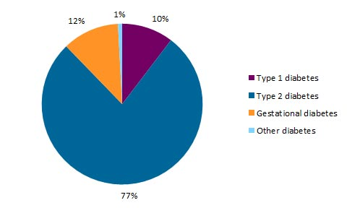
In today's era, diabetes is a global epidemic, with over 422 million people living with the disease in 2014. The prevalence of diabetes is expected to rise to 592 million by 2035.
The prevalence of type 1 diabetes is relatively low, but it is increasing in some parts of the world. The prevalence of type 2 diabetes is much higher, and it is increasing at an alarming rate.
Graph showing Spread of Type of Diabetes among Approximate Population

Slide 12
THANK YOU …

